Slide 1
Building an AI Chatbot from Scratch
Sam Yang
September 26th, 2024

Slide 2











Overview
Build a web-based AI-powered chatbot
+

Slide 3
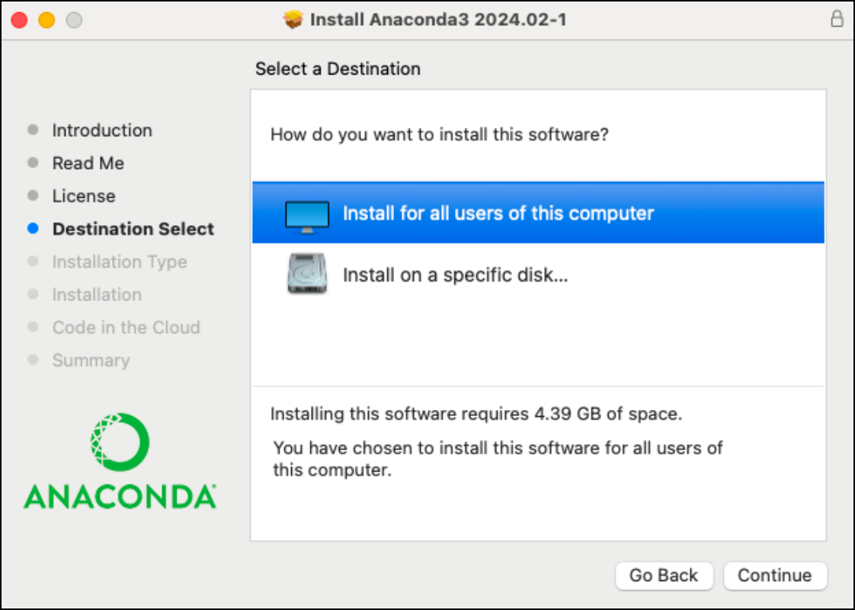
Install Anaconda
Windows: https://docs.anaconda.com/anaconda/install/windows/
Mac: https://docs.anaconda.com/anaconda/install/mac-os/
Linux: https://docs.anaconda.com/anaconda/install/linux/
Anaconda is an open-source distribution of the Python and R programming languages for data science that simplifies package management and deployment.

Slide 4
Create Folders
Django is a free, open-source web framework that helps developers build websites quickly and efficiently.
Create a Folder LLM:
mkdir LLM
Change directory to LLM:
cd LLM
Create a folder Django_project:
mkdir Django_project
Change directory to Django_project :
cd Django_project
├── LLM
│ └── Django_project
└── environment.yml

Slide 5
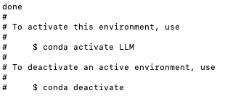
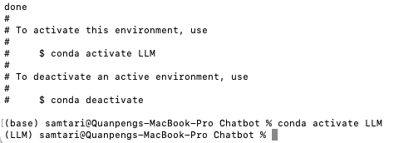
Create Virtual Environment from YML File
name: LLM
channels:
- defaults
dependencies:
- bzip2=1.0.8=h6c40b1e_6
- ca-certificates=2024.7.2=hecd8cb5_0
- expat=2.6.3=h6d0c2b6_0
- libcxx=14.0.6=h9765a3e_0
- libffi=3.4.4=hecd8cb5_1
- ncurses=6.4=hcec6c5f_0
- openssl=3.0.15=h46256e1_0
- pip=24.2=py312hecd8cb5_0
- python=3.12.3=hd58486a_1
- readline=8.2=hca72f7f_0
- setuptools=72.1.0=py312hecd8cb5_0
- sqlite=3.45.3=h6c40b1e_0
- tk=8.6.14=h4d00af3_0
- tzdata=2024a=h04d1e81_0
- wheel=0.44.0=py312hecd8cb5_0
- xz=5.4.6=h6c40b1e_1
- zlib=1.2.13=h4b97444_1
- pip:
- aiohappyeyeballs==2.4.0
- aiohttp==3.10.5
- aiosignal==1.3.1
- annotated-types==0.7.0
- anyio==4.4.0
- asgiref==3.8.1
- attrs==24.2.0
- certifi==2024.8.30
- charset-normalizer==3.3.2
- dataclasses-json==0.6.7
- django==5.1.1
- faiss-cpu==1.8.0.post1
- frozenlist==1.4.1
- greenlet==3.1.1
- h11==0.14.0
- httpcore==1.0.5
- httpx==0.27.2
- idna==3.10
- jsonpatch==1.33
- jsonpointer==3.0.0
- langchain==0.3.0
- langchain-community==0.3.0
- langchain-core==0.3.5
- langchain-text-splitters==0.3.0
- langsmith==0.1.125
- marshmallow==3.22.0
- multidict==6.1.0
- mypy-extensions==1.0.0
- numpy==1.26.4
- ollama==0.3.3
- orjson==3.10.7
- packaging==24.1
- pydantic==2.9.2
- pydantic-core==2.23.4
- pydantic-settings==2.5.2
- pymupdf==1.24.10
- pymupdfb==1.24.10
- python-dotenv==1.0.1
- pyyaml==6.0.2
- requests==2.32.3
- sniffio==1.3.1
- sqlalchemy==2.0.35
- sqlparse==0.5.1
- tenacity==8.5.0
- typing-extensions==4.12.2
- typing-inspect==0.9.0
- urllib3==2.2.3
- yarl==1.11.1
In terminal (Anaconda Prompt on Windows), type the command below and press ENTER key:
conda env create -f environment.yml
When the environment is created, you will see:
Activate the Virtual Environment:
conda activate LLM
If you see “(LLM)” at the beginning,
it means the LLM environment is activated:

Slide 6
Create Environment from requirements.txt File
In terminal (Anaconda Prompt on Windows), type the command below and press ENTER key:
conda create –-name LLM
Activate the Virtual Environment:
conda activate LLM
Install pip:
conda install pip
Install required packages:
pip install –r requirements.txt
If there is a “OpenSSL” related error when creating the environment:
This is due to .dll error
go to location where you've installed Anaconda Anaconda3>Library>bin. search and copy following dll files
libcrypto-1_1-x64.dll libssl-1_1-x64.dll
and paste to: Anaconda3>DLLs
then restart your terminal (or computer)
issue will get resolved.
aiohappyeyeballs==2.4.0
aiohttp==3.10.5
aiosignal==1.3.1
annotated-types==0.7.0
anyio==4.4.0
asgiref==3.8.1
attrs==24.2.0
certifi==2024.8.30
charset-normalizer==3.3.2
dataclasses-json==0.6.7
Django==5.1.1
faiss-cpu==1.8.0.post1
frozenlist==1.4.1
greenlet==3.1.1
h11==0.14.0
httpcore==1.0.5
httpx==0.27.2
idna==3.10
jsonpatch==1.33
jsonpointer==3.0.0
langchain==0.3.0
langchain-community==0.3.0
langchain-core==0.3.5
langchain-text-splitters==0.3.0
langsmith==0.1.125
marshmallow==3.22.0
multidict==6.1.0
mypy-extensions==1.0.0
numpy==1.26.4
ollama==0.3.3
orjson==3.10.7
packaging==24.1
pydantic==2.9.2
pydantic-settings==2.5.2
pydantic_core==2.23.4
PyMuPDF==1.24.10
PyMuPDFb==1.24.10
python-dotenv==1.0.1
PyYAML==6.0.2
requests==2.32.3
setuptools==72.1.0
sniffio==1.3.1
SQLAlchemy==2.0.35
sqlparse==0.5.1
tenacity==8.5.0
typing-inspect==0.9.0
typing_extensions==4.12.2
urllib3==2.2.3
wheel==0.44.0
yarl==1.11.1

Slide 7
Create a Django Project
├── LLM
│ └── Dj└── environment.yml
ango_project
In folder Django_project, create a project named ChatbotProject:
django-admin startproject ChatbotProject .
There will be some new files generated under the Django_project folder:
here
└── Django_project
├── ChatbotProject
│ ├── __init__.py
│ ├── asgi.py
│ ├── settings.py
│ ├── urls.py
│ └── wsgi.py
└── manage.py

Slide 8

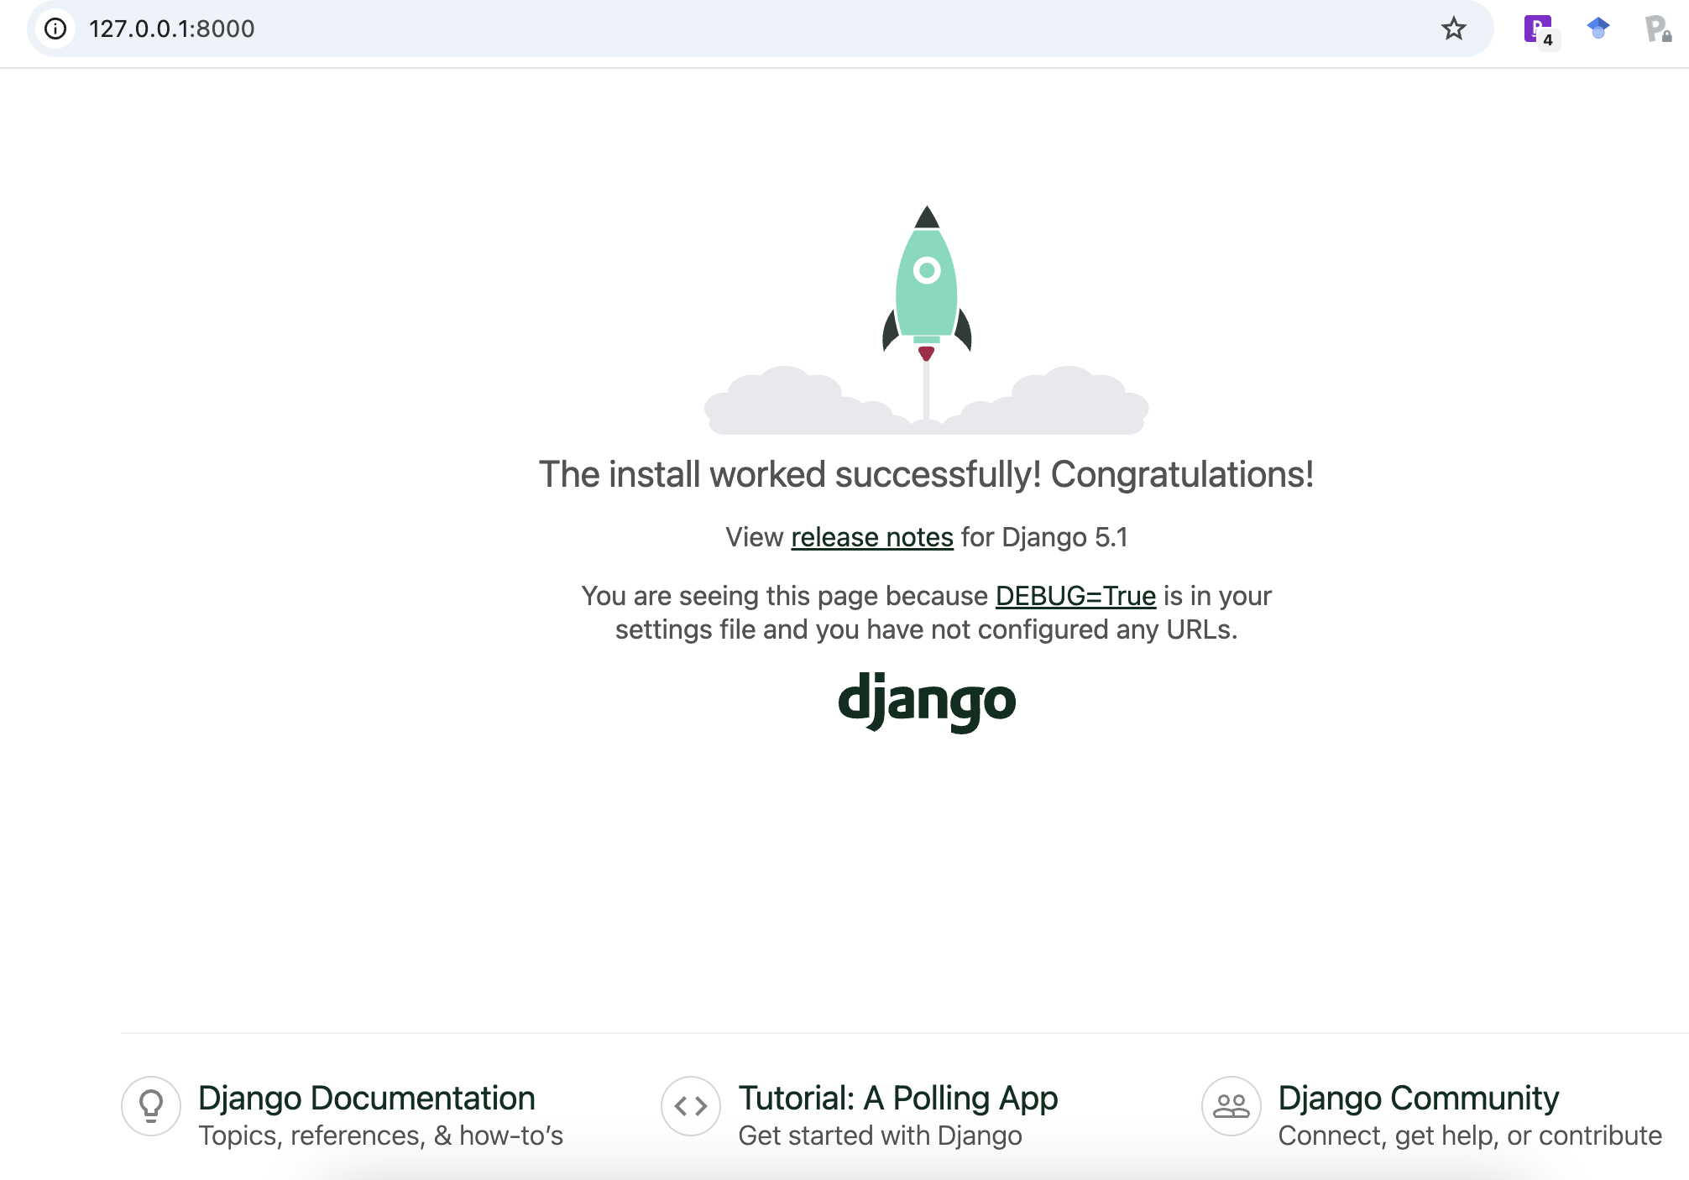
Verify if the Project Works:
└── Django_project
├── ChatbotProject
│ ├── __init__.py
│ ├── asgi.py
│ ├── settings.py
│ ├── urls.py
│ └── wsgi.py
└── manage.py
here
python manage.py runserver
You will see:
Access http://127.0.0.1:8000/ from a browser:
If you see this, congratulations! The project is built successfully!
If you want to exit:
CONTROL + Z (Windows)
COMMAND + Z (Mac)
But leaving it on is more convenient for the later development. Just open another terminal to continue. Don’t forget to activate environment.

Slide 9
Create an App: ChatbotApp
├── LLM
│ └── Django_project
└── environment.yml
python manage.py startapp ChatbotApp
here
There will be a new folder ChatbotApp and some files created:
├── ChatbotApp
│ ├── __init__.py
│ ├── admin.py
│ ├── apps.py
│ ├── migrations
│ │ └── __init__.py
│ ├── models.py
│ ├── tests.py
│ └── views.py
├── ChatbotProject
├── db.sqlite3
└── manage.py
Then, add ChatbotApp to settings
Edit settings.py file in ChatbotProject folder:
Add ‘ChatbotApp’, to INSTALLED_APPS list:
INSTALLED_APPS = [
'django.contrib.admin',
'django.contrib.auth',
'django.contrib.contenttypes',
'django.contrib.sessions',
'django.contrib.messages',
'django.contrib.staticfiles',
'ChatbotApp',
]

Slide 10
Create a Template for Webpage
Create a folder templetes under ChatbotApp for templates:
─── ChatbotApp
├── __init__.py
├── admin.py
├── apps.py
├── migrations
│ └── __init__.py
├── models.py
├── templates
│ └── chatbot.html
├── tests.py
└── views.py
Then create a file chatbot.html under templetes as a template:
Edit chatbot.html
<!DOCTYPE html>
<html>
<head>
<title>LLM Response</title>
</head>
<body style="height: 100%; margin: 0; display: flex; justify-content: center; align-items: center;">
<div style="text-align: center;">
<h1>My Chatbot</h1>
<p>{{ response }}</p>
</div>
</body>
</html>

Slide 11
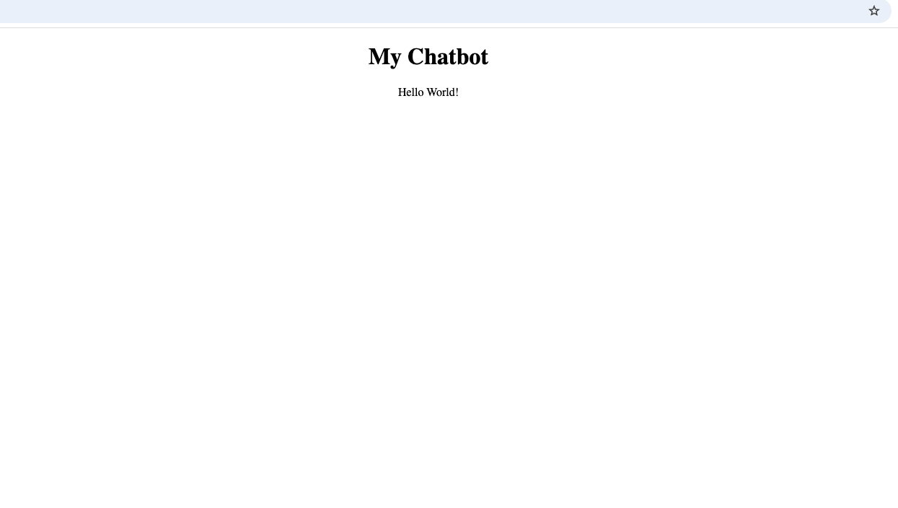
Print “Hello World!”
Create a function:
Edit the views.py file under ChatbotApp folder:
from django.shortcuts import render
def helloFunction(request):
response = {"response": "Hello World!"}
return render(request, 'chatbot.html', response)
Make Connections using urls.py
├── ChatbotProject
│ ├── asgi.py
│ ├── settings.py
│ ├── urls.py
│ └── wsgi.py
│
├── ChatbotApp
│ ├── admin.py
│ ├── apps.py
│ ├── migrations
│ ├── models.py
│ ├── templates
│ ├── tests.py
│ ├── urls.py
│ └── views.py
Edit the urls.py under the ChatbotProject folder:
from django.urls import path, include
urlpatterns = [
path('', include('ChatbotApp.urls')),
]
Connect Project and Apps
Create a urls.py under the ChatbotApp folder:
from django.urls import path
from . import views
urlpatterns = [
path('', views.helloFunction, name='helloFunction'),
]
Connect App and Functions

Slide 12
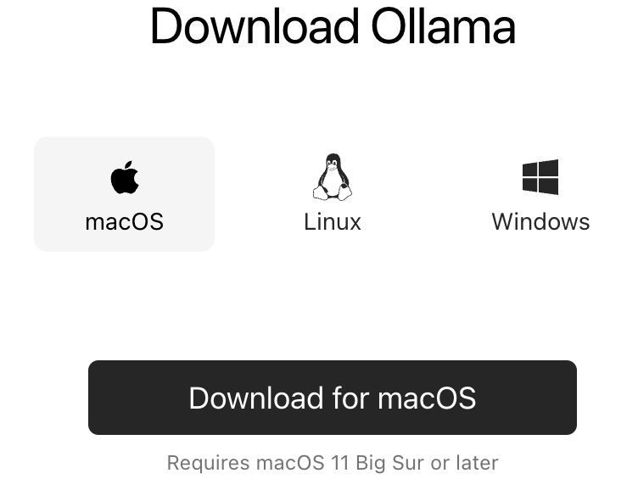
Install Ollama
https://ollama.com/download
might need to open a new terminal

Slide 13
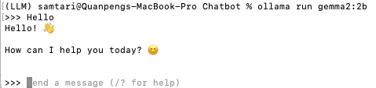
Install a Large Language Model
ollama pull gemma2:2b
ollama run gemma2:2b

Slide 14
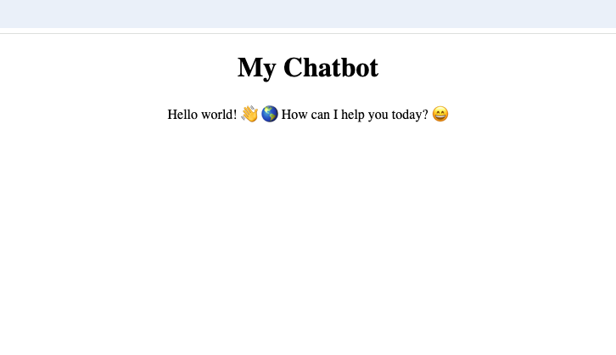
First LLM Output
Edit the views.py file under ChatbotApp folder:
from django.shortcuts import render
import ollama
LLM_Model = 'gemma2:2b'
def LLM(prompt):
response = ollama.chat(model=LLM_Model, messages=[{'role': 'user', 'content': prompt}])
return response['message']['content']
def helloFunction(request):
response = LLM("Hello world!")
response = {"response": response}
return render(request, 'chatbot.html', response)

Slide 15
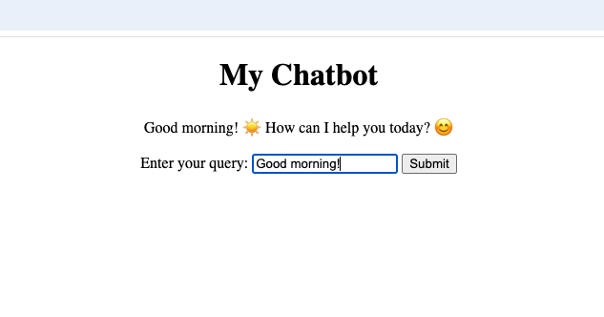
Interact with Chatbot
Edit the views.py file under ChatbotApp folder:
from django.shortcuts import render
import ollama
LLM_Model = 'gemma2:2b'
def LLM(prompt):
response = ollama.chat(model=LLM_Model, messages=[{'role': 'user', 'content': prompt}])
return response['message']['content']
def helloFunction(request):
userInput = request.GET.get('userInput')
response = LLM(userInput)
response = {"response": response}
return render(request, 'chatbot.html', response)
Edit the chatbot.html file under templates folder:
<!DOCTYPE html>
<html>
<head>
<title>LLM Response</title>
</head>
<body style="height: 100%; margin: 0; display: flex; justify-content: center; align-items: center;">
<div style="text-align: center;">
<h1>My Chatbot</h1>
<p>{{ response }}</p>
<form method="GET" action="{% url 'helloFunction' %}">
<label for="userInput">Enter your query:</label>
<input type="text" name="userInput" placeholder="Chat with me" required>
<button type="submit">Submit</button>
</form>
</div>
</body>
</html>

Slide 16
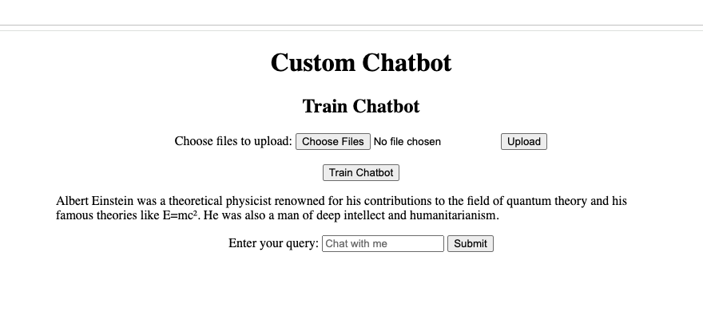
Chat with Your Files
from django.shortcuts import render
import ollama
from langchain_community.llms import Ollama
from langchain_community.document_loaders import DirectoryLoader, PyMuPDFLoader
from langchain_community.embeddings import OllamaEmbeddings
from langchain_community.vectorstores import FAISS
from langchain.text_splitter import RecursiveCharacterTextSplitter
import os
import shutil
from django.core.files.storage import default_storage
from langchain.prompts import ChatPromptTemplate
from langchain.chains import create_retrieval_chain
from langchain.chains.combine_documents import create_stuff_documents_chain
import requests
from django.http import JsonResponse
LLM_Model = 'gemma2:2b'
def LLM(prompt):
response = ollama.chat(model=LLM_Model, messages=[{'role': 'user', 'content': prompt}])
return response['message']['content']
def helloFunction(request):
userInput = request.GET.get('userInput')
response = LLM(userInput)
response = {"response": response}
return render(request, 'chatbot.html', response)
def customChatbot(request):
userInput = request.GET.get('userInput')
response = RAG(userInput)
response = {"response": response}
return render(request, 'customChatbot.html', response)
def upload_files(request):
if request.method == 'POST' and request.FILES.getlist('files[]'):
# Get the list of uploaded files
uploaded_files = request.FILES.getlist('files[]')
# Define the base directory where files will be saved
BASE_DIR = os.path.dirname(os.path.abspath(__file__))
DATA_PATH = os.path.join(BASE_DIR, 'data')
# Ensure the 'data' directory exists
if not os.path.exists(DATA_PATH):
os.makedirs(DATA_PATH)
# Process each file
success_messages = []
for uploaded_file in uploaded_files:
file_path = os.path.join(DATA_PATH, uploaded_file.name)
# Save the file to the 'data' directory
with default_storage.open(file_path, 'wb+') as destination:
for chunk in uploaded_file.chunks():
destination.write(chunk)
success_messages.append(f'File "{uploaded_file.name}" uploaded successfully!')
# Return a response indicating success for all files
alert = {'response': success_messages}
return render(request, 'customChatbot.html', alert)
else:
# If no files were uploaded, return an error
alert = {'error': 'No files uploaded.'}
return render(request, 'customChatbot.html', alert)
def RAG(user_input):
BASE_DIR = os.path.dirname(os.path.abspath(__file__))
FAISS_PATH = os.path.join(BASE_DIR, "faiss_index")
# Set up the local model
llm = Ollama(model=LLM_Model)
# Load the FAISS index with allow_dangerous_deserialization set to True
vector_store = FAISS.load_local(
FAISS_PATH,
OllamaEmbeddings(model=LLM_Model),
allow_dangerous_deserialization=True
)
# Set up the query prompt
prompt = ChatPromptTemplate.from_template(
"""
Answer the following question only based on the given context:
<context>
{context}
</context>
Question: {input}
""")
# Retrieve context from vector store
docs_chain = create_stuff_documents_chain(llm, prompt)
retriever = vector_store.as_retriever()
retrieval_chain = create_retrieval_chain(retriever, docs_chain)
# Perform the query
response = retrieval_chain.invoke({"input": user_input})
print(":::QUERY RESPONSE:::")
print(response["answer"])
return response["answer"]
def train(request):
def generate_data_store():
documents = load_documents()
chunks = split_text(documents)
save_to_faiss(chunks)
return JsonResponse({'status': 'success'})
def load_documents():
# Load documents from a local directory
loader = DirectoryLoader(DATA_PATH, glob="*.pdf", loader_cls=PyMuPDFLoader)
documents = loader.load()
return documents
def split_text(documents):
# Split documents into manageable chunks
text_splitter = RecursiveCharacterTextSplitter(
chunk_size=300,
chunk_overlap=100,
length_function=len,
add_start_index=True,)
chunks = text_splitter.split_documents(documents)
print(f"Split {len(documents)} documents into {len(chunks)} chunks.")
return chunks
def save_to_faiss(chunks):
# Clear out the database first
if os.path.exists(FAISS_PATH):
shutil.rmtree(FAISS_PATH)
# Create embeddings using Ollama's local model
embeddings = OllamaEmbeddings(model=LLM_Model)
# Initialize FAISS vector store
vector_store = FAISS.from_documents(chunks, embeddings)
# Save FAISS index
vector_store.save_local(FAISS_PATH)
print(f"Saved {len(chunks)} chunks to {FAISS_PATH} using FAISS.")
# Dynamically point to the 'data' folder in the same directory as this script
BASE_DIR = os.path.dirname(os.path.abspath(__file__))
FAISS_PATH = os.path.join(BASE_DIR, "faiss_index")
DATA_PATH = os.path.join(BASE_DIR, "data")
generate_data_store()
response = {'response': "Chatbot trained successfully!"} # Pass response to template
return render(request, 'customChatbot.html', response) # Render the HTML page with response
Use your documents to customize the chatbot
Create a new template customChatbot.html under templates folder
templates/customChatbot.html
from django.shortcuts import render
import ollama
from langchain_community.llms import Ollama
from langchain_community.document_loaders import DirectoryLoader, PyMuPDFLoader
from langchain_community.embeddings import OllamaEmbeddings
from langchain_community.vectorstores import FAISS
from langchain.text_splitter import RecursiveCharacterTextSplitter
import os
import shutil
from django.core.files.storage import default_storage
from langchain.prompts import ChatPromptTemplate
from langchain.chains import create_retrieval_chain
from langchain.chains.combine_documents import create_stuff_documents_chain
import requests
from django.http import JsonResponse
LLM_Model = 'gemma2:2b'
def LLM(prompt):
response = ollama.chat(model=LLM_Model, messages=[{'role': 'user', 'content': prompt}])
return response['message']['content']
def helloFunction(request):
userInput = request.GET.get('userInput')
response = LLM(userInput)
response = {"response": response}
return render(request, 'chatbot.html', response)
def customChatbot(request):
userInput = request.GET.get('userInput')
# Check if the FAISS index exists
BASE_DIR = os.path.dirname(os.path.abspath(__file__))
FAISS_PATH = os.path.join(BASE_DIR, "faiss_index", "index.faiss") # Add 'index.faiss' to path
if os.path.exists(FAISS_PATH):
# If the FAISS index exists, proceed with the RAG function
response = RAG(userInput)
else:
# If the FAISS index does not exist, prompt the user to train the chatbot first
response = "Please train the chatbot first."
response = {"response": response}
return render(request, 'customChatbot.html', response)
def upload_files(request):
if request.method == 'POST' and request.FILES.getlist('files[]'):
# Get the list of uploaded files
uploaded_files = request.FILES.getlist('files[]')
# Define the base directory where files will be saved
BASE_DIR = os.path.dirname(os.path.abspath(__file__))
DATA_PATH = os.path.join(BASE_DIR, 'data')
# Ensure the 'data' directory exists
if not os.path.exists(DATA_PATH):
os.makedirs(DATA_PATH)
# Process each file
success_messages = []
for uploaded_file in uploaded_files:
file_path = os.path.join(DATA_PATH, uploaded_file.name)
# Save the file to the 'data' directory
with default_storage.open(file_path, 'wb+') as destination:
for chunk in uploaded_file.chunks():
destination.write(chunk)
success_messages.append(f'File "{uploaded_file.name}" uploaded successfully!')
# Return a response indicating success for all files
alert = {'response': success_messages}
return render(request, 'customChatbot.html', alert)
else:
# If no files were uploaded, return an error
alert = {'error': 'No files uploaded.'}
return render(request, 'customChatbot.html', alert)
def RAG(user_input):
BASE_DIR = os.path.dirname(os.path.abspath(__file__))
FAISS_PATH = os.path.join(BASE_DIR, "faiss_index")
# Set up the local model
llm = Ollama(model=LLM_Model)
# Load the FAISS index with allow_dangerous_deserialization set to True
vector_store = FAISS.load_local(
FAISS_PATH,
OllamaEmbeddings(model=LLM_Model),
allow_dangerous_deserialization=True
)
# Set up the query prompt
prompt = ChatPromptTemplate.from_template(
"""
Answer the following question only based on the given context:
<context>
{context}
</context>
Question: {input}
""")
# Retrieve context from vector store
docs_chain = create_stuff_documents_chain(llm, prompt)
retriever = vector_store.as_retriever()
retrieval_chain = create_retrieval_chain(retriever, docs_chain)
# Perform the query
response = retrieval_chain.invoke({"input": user_input})
print(":::QUERY RESPONSE:::")
print(response["answer"])
return response["answer"]
def train(request):
def generate_data_store():
documents = load_documents()
chunks = split_text(documents)
save_to_faiss(chunks)
return JsonResponse({'status': 'success'})
def load_documents():
# Load documents from a local directory
loader = DirectoryLoader(DATA_PATH, glob="*.pdf", loader_cls=PyMuPDFLoader)
documents = loader.load()
return documents
def split_text(documents):
# Split documents into manageable chunks
text_splitter = RecursiveCharacterTextSplitter(
chunk_size=300,
chunk_overlap=100,
length_function=len,
add_start_index=True,
)
chunks = text_splitter.split_documents(documents)
print(f"Split {len(documents)} documents into {len(chunks)} chunks.")
return chunks
def save_to_faiss(chunks):
# Clear out the database first
if os.path.exists(FAISS_PATH):
shutil.rmtree(FAISS_PATH)
embeddings = OllamaEmbeddings(model=LLM_Model)
vector_store = FAISS.from_documents(chunks, embeddings)
vector_store.save_local(FAISS_PATH)
print(f"Saved {len(chunks)} chunks to {FAISS_PATH} using FAISS.")
# Dynamically point to the 'data' folder in the same directory as this script
BASE_DIR = os.path.dirname(os.path.abspath(__file__))
FAISS_PATH = os.path.join(BASE_DIR, "faiss_index")
DATA_PATH = os.path.join(BASE_DIR, "data")
generate_data_store()
response = {'response': "Chatbot trained successfully!"}
return render(request, 'customChatbot.html', response)
<!DOCTYPE html>
<html>
<head>
<title>LLM Response</title>
</head>
<body style="height: 100%; margin: 0; display: flex; justify-content: center; align-items: center;">
<div style="text-align: center;">
<h1>Custom Chatbot</h1>
<h2>Train Chatbot</h2>
<form method="POST" action="/upload" enctype="multipart/form-data">
{% csrf_token %}
<label for="file">Choose files to upload:</label>
<input type="file" id="file" name="files[]" multiple required>
<button type="submit">Upload</button>
</form>
<br />
<form method="POST" action="/train">
{% csrf_token %}
<button type="submit">Train Chatbot</button> {{ alert }}
</form>
<p>{{ response }}</p>
<form method="GET" action="{% url 'customChatbot' %}">
<label for="userInput">Enter your query:</label>
<input type="text" name="userInput" placeholder="Chat with me" required>
<button type="submit">Submit</button>
</form>
</div>
</body>
</html>
Edit the views.py file under ChatbotApp folder:
Edit the urls.py file under ChatbotApp folder:
from django.urls import path
from . import views
urlpatterns = [
path('', views.helloFunction, name='helloFunction'),
path('customChatbot', views.customChatbot, name='customChatbot'),
path('upload', views.upload_files, name='upload_files'),
path('train', views.train, name='train'),
]

Slide 17
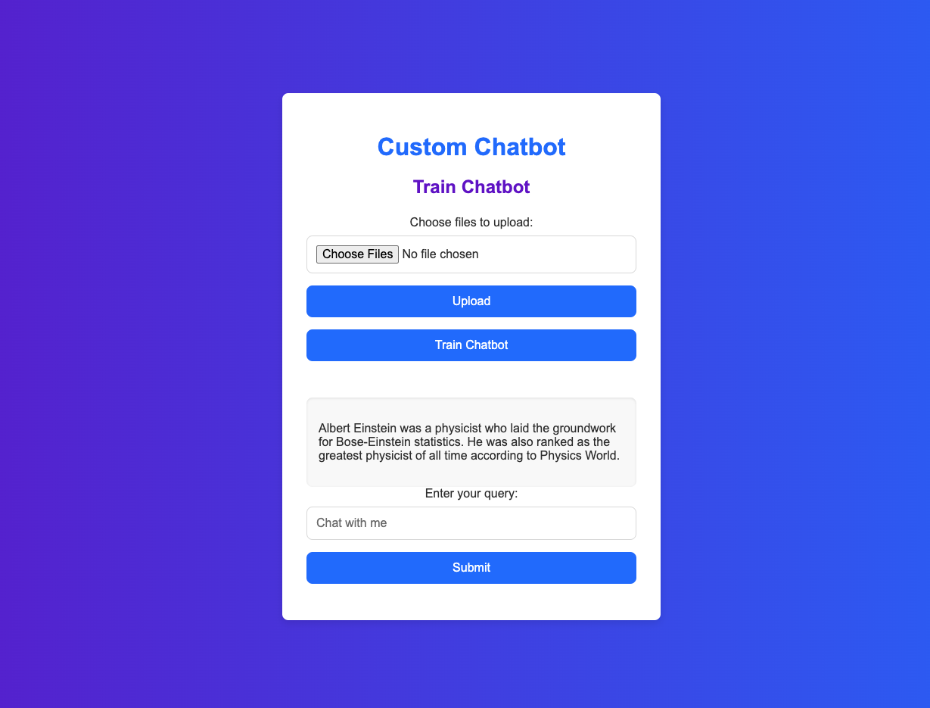
Make it look nicer
from django.shortcuts import render
import ollama
from langchain_community.llms import Ollama
from langchain_community.document_loaders import DirectoryLoader, PyMuPDFLoader
from langchain_community.embeddings import OllamaEmbeddings
from langchain_community.vectorstores import FAISS
from langchain.text_splitter import RecursiveCharacterTextSplitter
import os
import shutil
from django.core.files.storage import default_storage
from langchain.prompts import ChatPromptTemplate
from langchain.chains import create_retrieval_chain
from langchain.chains.combine_documents import create_stuff_documents_chain
import requests
from django.http import JsonResponse
LLM_Model = 'gemma2:2b'
def LLM(prompt):
response = ollama.chat(model=LLM_Model, messages=[{'role': 'user', 'content': prompt}])
return response['message']['content']
def helloFunction(request):
userInput = request.GET.get('userInput')
response = LLM(userInput)
response = {"response": response}
return render(request, 'chatbot.html', response)
def customChatbot(request):
userInput = request.GET.get('userInput')
response = RAG(userInput)
response = {"response": response}
return render(request, 'customChatbot.html', response)
def upload_files(request):
if request.method == 'POST' and request.FILES.getlist('files[]'):
# Get the list of uploaded files
uploaded_files = request.FILES.getlist('files[]')
# Define the base directory where files will be saved
BASE_DIR = os.path.dirname(os.path.abspath(__file__))
DATA_PATH = os.path.join(BASE_DIR, 'data')
# Ensure the 'data' directory exists
if not os.path.exists(DATA_PATH):
os.makedirs(DATA_PATH)
# Process each file
success_messages = []
for uploaded_file in uploaded_files:
file_path = os.path.join(DATA_PATH, uploaded_file.name)
# Save the file to the 'data' directory
with default_storage.open(file_path, 'wb+') as destination:
for chunk in uploaded_file.chunks():
destination.write(chunk)
success_messages.append(f'File "{uploaded_file.name}" uploaded successfully!')
# Return a response indicating success for all files
alert = {'response': success_messages}
return render(request, 'customChatbot.html', alert)
else:
# If no files were uploaded, return an error
alert = {'error': 'No files uploaded.'}
return render(request, 'customChatbot.html', alert)
def RAG(user_input):
BASE_DIR = os.path.dirname(os.path.abspath(__file__))
FAISS_PATH = os.path.join(BASE_DIR, "faiss_index")
# Set up the local model
llm = Ollama(model=LLM_Model)
# Load the FAISS index with allow_dangerous_deserialization set to True
vector_store = FAISS.load_local(
FAISS_PATH,
OllamaEmbeddings(model=LLM_Model),
allow_dangerous_deserialization=True
)
# Set up the query prompt
prompt = ChatPromptTemplate.from_template(
"""
Answer the following question only based on the given context:
<context>
{context}
</context>
Question: {input}
""")
# Retrieve context from vector store
docs_chain = create_stuff_documents_chain(llm, prompt)
retriever = vector_store.as_retriever()
retrieval_chain = create_retrieval_chain(retriever, docs_chain)
# Perform the query
response = retrieval_chain.invoke({"input": user_input})
print(":::QUERY RESPONSE:::")
print(response["answer"])
return response["answer"]
def train(request):
def generate_data_store():
documents = load_documents()
chunks = split_text(documents)
save_to_faiss(chunks)
return JsonResponse({'status': 'success'})
def load_documents():
# Load documents from a local directory
loader = DirectoryLoader(DATA_PATH, glob="*.pdf", loader_cls=PyMuPDFLoader)
documents = loader.load()
return documents
def split_text(documents):
# Split documents into manageable chunks
text_splitter = RecursiveCharacterTextSplitter(
chunk_size=300,
chunk_overlap=100,
length_function=len,
add_start_index=True,)
chunks = text_splitter.split_documents(documents)
print(f"Split {len(documents)} documents into {len(chunks)} chunks.")
return chunks
def save_to_faiss(chunks):
# Clear out the database first
if os.path.exists(FAISS_PATH):
shutil.rmtree(FAISS_PATH)
# Create embeddings using Ollama's local model
embeddings = OllamaEmbeddings(model=LLM_Model)
# Initialize FAISS vector store
vector_store = FAISS.from_documents(chunks, embeddings)
# Save FAISS index
vector_store.save_local(FAISS_PATH)
print(f"Saved {len(chunks)} chunks to {FAISS_PATH} using FAISS.")
# Dynamically point to the 'data' folder in the same directory as this script
BASE_DIR = os.path.dirname(os.path.abspath(__file__))
FAISS_PATH = os.path.join(BASE_DIR, "faiss_index")
DATA_PATH = os.path.join(BASE_DIR, "data")
generate_data_store()
response = {'response': "Chatbot trained successfully!"} # Pass response to template
return render(request, 'customChatbot.html', response) # Render the HTML page with response
<!DOCTYPE html>
<html lang="en">
<head>
<meta charset="UTF-8">
<meta name="viewport" content="width=device-width, initial-scale=1.0">
<title>LLM Response</title>
<style>
:root {
--primary-color: #2575fc;
--secondary-color: #6a11cb;
--background-gradient: linear-gradient(to right, #6a11cb, #2575fc);
--text-color: #333;
--button-color: #fff;
--button-hover-bg: #4c9fff;
--input-border: #ddd;
--border-radius: 8px;
}
* {
box-sizing: border-box;
}
body {
height: 100vh;
margin: 0;
font-family: 'Arial', sans-serif;
display: flex;
justify-content: center;
align-items: center;
background: var(--background-gradient);
color: var(--text-color);
}
.container {
background-color: #fff;
padding: 2rem;
border-radius: var(--border-radius);
box-shadow: 0 4px 10px rgba(0, 0, 0, 0.1);
width: 100%;
max-width: 500px;
text-align: center;
}
h1 {
font-size: 2rem;
color: var(--primary-color);
margin-bottom: 1rem;
}
h2 {
font-size: 1.5rem;
color: var(--secondary-color);
margin-bottom: 1.5rem;
}
label {
display: block;
margin-bottom: 0.5rem;
font-size: 1rem;
}
input[type="file"],
input[type="text"] {
width: 100%;
padding: 0.75rem;
margin-bottom: 1rem;
border: 1px solid var(--input-border);
border-radius: var(--border-radius);
font-size: 1rem;
}
button {
background-color: var(--primary-color);
color: var(--button-color);
padding: 0.75rem 1.5rem;
border: none;
border-radius: var(--border-radius);
font-size: 1rem;
cursor: pointer;
transition: background-color 0.3s ease;
margin-bottom: 1rem;
width: 100%;
}
button:hover {
background-color: var(--button-hover-bg);
}
.response-container {
margin-top: 2rem;
padding: 1rem;
background-color: #f9f9f9;
border-radius: var(--border-radius);
box-shadow: inset 0 1px 3px rgba(0, 0, 0, 0.1);
text-align: left;
max-width: 100%;
}
</style>
</head>
<body>
<div class="container">
<h1>Custom Chatbot</h1>
<h2>Train Chatbot</h2>
<form method="POST" action="/upload" enctype="multipart/form-data">
{% csrf_token %}
<label for="file">Choose files to upload:</label>
<input type="file" id="file" name="files[]" multiple required>
<button type="submit">Upload</button>
</form>
<form method="POST" action="/train">
{% csrf_token %}
<button type="submit">Train Chatbot</button> {{ alert }}
</form>
<div class="response-container">
<p>{{ response }}</p>
</div>
<form method="GET" action="{% url 'customChatbot' %}">
<label for="userInput">Enter your query:</label>
<input type="text" name="userInput" placeholder="Chat with me" required>
<button type="submit">Submit</button>
</form>
</div>
</body>
</html>
Update template customChatbot.html under templates folder
templates/customChatbot.html

Slide 18
Bonus: Weather App
Provide suggestion on what to wear based on weather prediction
views.py
templates/weather.html
urls.py
from django.shortcuts import render
import ollama
from langchain_community.llms import Ollama
from langchain_community.document_loaders import DirectoryLoader, PyMuPDFLoader
from langchain_community.embeddings import OllamaEmbeddings
from langchain_community.vectorstores import FAISS
from langchain.text_splitter import RecursiveCharacterTextSplitter
import os
import shutil
from django.core.files.storage import default_storage
from langchain.prompts import ChatPromptTemplate
from langchain.chains import create_retrieval_chain
from langchain.chains.combine_documents import create_stuff_documents_chain
import requests
from django.http import JsonResponse
LLM_Model = 'gemma2:2b'
def LLM(prompt):
response = ollama.chat(model=LLM_Model, messages=[{'role': 'user', 'content': prompt}])
return response['message']['content']
def helloFunction(request):
userInput = request.GET.get('userInput')
response = LLM(userInput)
response = {"response": response}
return render(request, 'chatbot.html', response)
def customChatbot(request):
userInput = request.GET.get('userInput')
response = RAG(userInput)
response = {"response": response}
return render(request, 'customChatbot.html', response)
def upload_files(request):
if request.method == 'POST' and request.FILES.getlist('files[]'):
# Get the list of uploaded files
uploaded_files = request.FILES.getlist('files[]')
# Define the base directory where files will be saved
BASE_DIR = os.path.dirname(os.path.abspath(__file__))
DATA_PATH = os.path.join(BASE_DIR, 'data')
# Ensure the 'data' directory exists
if not os.path.exists(DATA_PATH):
os.makedirs(DATA_PATH)
# Process each file
success_messages = []
for uploaded_file in uploaded_files:
file_path = os.path.join(DATA_PATH, uploaded_file.name)
# Save the file to the 'data' directory
with default_storage.open(file_path, 'wb+') as destination:
for chunk in uploaded_file.chunks():
destination.write(chunk)
success_messages.append(f'File "{uploaded_file.name}" uploaded successfully!')
# Return a response indicating success for all files
alert = {'response': success_messages}
return render(request, 'customChatbot.html', alert)
else:
# If no files were uploaded, return an error
alert = {'error': 'No files uploaded.'}
return render(request, 'customChatbot.html', alert)
def RAG(user_input):
BASE_DIR = os.path.dirname(os.path.abspath(__file__))
FAISS_PATH = os.path.join(BASE_DIR, "faiss_index")
# Set up the local model
llm = Ollama(model=LLM_Model)
# Load the FAISS index with allow_dangerous_deserialization set to True
vector_store = FAISS.load_local(
FAISS_PATH,
OllamaEmbeddings(model=LLM_Model),
allow_dangerous_deserialization=True
)
# Set up the query prompt
prompt = ChatPromptTemplate.from_template(
"""
Answer the following question only based on the given context:
<context>
{context}
</context>
Question: {input}
""")
# Retrieve context from vector store
docs_chain = create_stuff_documents_chain(llm, prompt)
retriever = vector_store.as_retriever()
retrieval_chain = create_retrieval_chain(retriever, docs_chain)
# Perform the query
response = retrieval_chain.invoke({"input": user_input})
print(":::QUERY RESPONSE:::")
print(response["answer"])
return response["answer"]
def train(request):
def generate_data_store():
documents = load_documents()
chunks = split_text(documents)
save_to_faiss(chunks)
return JsonResponse({'status': 'success'})
def load_documents():
# Load documents from a local directory
loader = DirectoryLoader(DATA_PATH, glob="*.pdf", loader_cls=PyMuPDFLoader)
documents = loader.load()
return documents
def split_text(documents):
# Split documents into manageable chunks
text_splitter = RecursiveCharacterTextSplitter(
chunk_size=300,
chunk_overlap=100,
length_function=len,
add_start_index=True,)
chunks = text_splitter.split_documents(documents)
print(f"Split {len(documents)} documents into {len(chunks)} chunks.")
return chunks
def save_to_faiss(chunks):
# Clear out the database first
if os.path.exists(FAISS_PATH):
shutil.rmtree(FAISS_PATH)
# Create embeddings using Ollama's local model
embeddings = OllamaEmbeddings(model=LLM_Model)
# Initialize FAISS vector store
vector_store = FAISS.from_documents(chunks, embeddings)
# Save FAISS index
vector_store.save_local(FAISS_PATH)
print(f"Saved {len(chunks)} chunks to {FAISS_PATH} using FAISS.")
# Dynamically point to the 'data' folder in the same directory as this script
BASE_DIR = os.path.dirname(os.path.abspath(__file__))
FAISS_PATH = os.path.join(BASE_DIR, "faiss_index")
DATA_PATH = os.path.join(BASE_DIR, "data")
generate_data_store()
response = {'response': "Chatbot trained successfully!"} # Pass response to template
return render(request, 'customChatbot.html', response) # Render the HTML page with response
def weather(request):
try:
ip_address = request.GET.get('ip_address') # Default IP address if not provided
tone = request.GET.get('tone', 'normal') # Default tone if not provided
# Get coordinates based on IP address
coordinate = get_coordinate_from_ip(ip_address)
# Fetch weather forecast
foreCast = requests.get(f"https://api.weather.gov/points/{coordinate[0]},{coordinate[1]}")
# Fetch location details (city, state, country)
location_info = get_ip_geolocation(ip_address)
city = location_info.get('city', 'Unknown City')
state = location_info.get('region', 'Unknown State')
country = location_info.get('country', 'Unknown Country')
location_str = f"{city}, {state}, {country}"
# Fetch weather forecast details
forecastUrl = foreCast.json()["properties"]["forecast"]
forecastContent = requests.get(f"{forecastUrl}").json()
first_period_detailed_forecast = forecastContent["properties"]["periods"][0]["detailedForecast"]
# Construct query for LLM
query = f"""
You are a helpful assistant. Given the following weather conditions:
{first_period_detailed_forecast},
please provide a suggestion on what to wear.
Note: say it in a {tone} way.
"""
# Generate response from LLM
response_content = LLM(query)
# Pass the response and location details to the template
context = {
'response': response_content,
'location': location_str
}
# Render the HTML page with the response and location information
return render(request, 'weather.html', context)
except Exception as e:
print(f"An error occurred: {e}")
return render(request, 'weather.html', {'error': 'An error occurred. Please try again later.'})
def get_coordinate_from_ip(ip_address):
try:
response = requests.get(f"https://ipinfo.io/{ip_address}/json")
data = response.json()
if "loc" in data:
loc = data["loc"]
latitude, longitude = loc.split(",")
return float(latitude), float(longitude)
else:
print("Location information is not available for this IP address.")
return None
except Exception as e:
print(f"An error occurred: {e}")
return None
def get_ip_geolocation(ip_address):
url = f'http://ip-api.com/json/{ip_address}'
response = requests.get(url)
data = response.json()
if data['status'] == 'success':
return {
'ip': data.get('query'),
'city': data.get('city'),
'region': data.get('regionName'),
'country': data.get('country'),
'location': f"{data.get('lat')}, {data.get('lon')}",
'postal': data.get('zip'),
'timezone': data.get('timezone')
}
else:
return {"error": "Could not retrieve data"}
<!DOCTYPE html>
<html>
<head>
<title>AI Weather Assistant</title>
</head>
<body style="height: 100%; margin: 0; display: flex; justify-content: center; align-items: center;">
<div style="text-align: center;">
<script>
document.addEventListener('DOMContentLoaded', function() {
// Check if the ip-hidden input is empty, then fetch the IP
const ipInput = document.getElementById('ip-hidden');
if (!ipInput.value) {
fetch('https://api.ipify.org?format=json')
.then(response => response.json())
.then(data => {
ipInput.value = data.ip;
})
.catch(error => console.error('Error fetching IP:', error));
}
});
</script>
<h1>AI Weather Assistant</h1>
<form method="GET" action="{% url 'weather' %}">
<label for="ip">IP Address:</label>
<input type="text" id="ip-hidden" name="ip_address" placeholder="IP address" value="{{ ip_address|default_if_none:'' }}" required> {{ location }}
<br>
<label for="tone">Enter the tone:</label>
<input type="text" name="tone" placeholder="set a tone for response" value="{{ tone|default:'normal' }}" required>
<button type="submit">Submit</button>
</form>
<div style="width: 40%; margin: 0 auto; text-align: left;">
<p>{{ response }}</p>
</div>
</div>
</body>
</html>
from django.urls import path
from . import views
urlpatterns = [
path('', views.helloFunction, name='helloFunction'),
path('customChatbot', views.customChatbot, name='customChatbot'),
path('upload', views.upload_files, name='upload_files'),
path('train', views.train, name='train'),
path('weather/', views.weather, name='weather'),
]

Slide 19
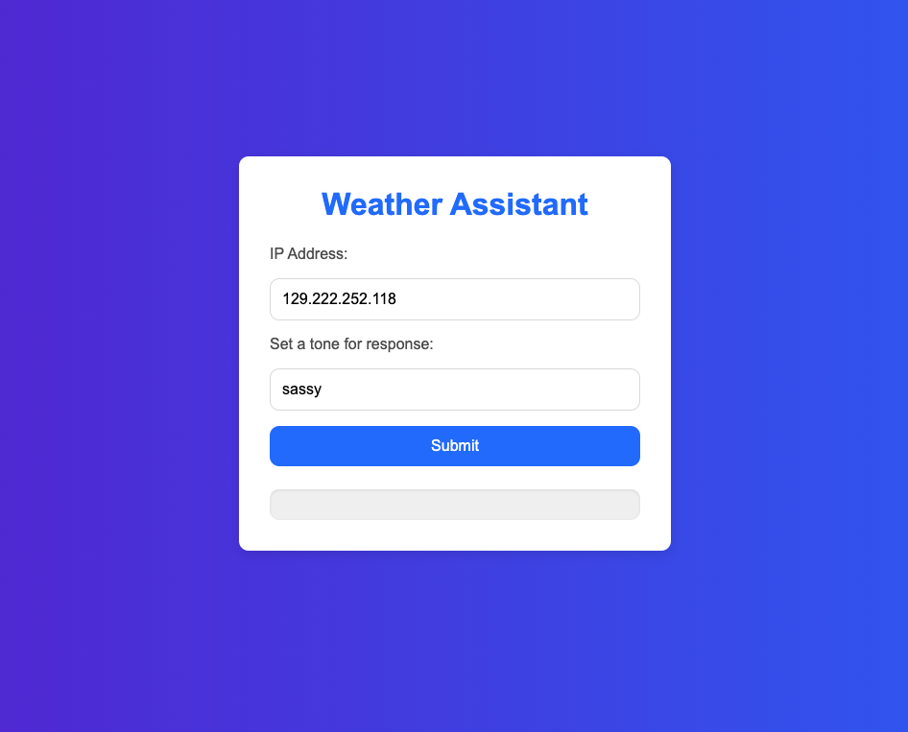
Make it look nicer
from django.shortcuts import render
import ollama
from langchain_community.llms import Ollama
from langchain_community.document_loaders import DirectoryLoader, PyMuPDFLoader
from langchain_community.embeddings import OllamaEmbeddings
from langchain_community.vectorstores import FAISS
from langchain.text_splitter import RecursiveCharacterTextSplitter
import os
import shutil
from django.core.files.storage import default_storage
from langchain.prompts import ChatPromptTemplate
from langchain.chains import create_retrieval_chain
from langchain.chains.combine_documents import create_stuff_documents_chain
import requests
from django.http import JsonResponse
LLM_Model = 'gemma2:2b'
def LLM(prompt):
response = ollama.chat(model=LLM_Model, messages=[{'role': 'user', 'content': prompt}])
return response['message']['content']
def helloFunction(request):
userInput = request.GET.get('userInput')
response = LLM(userInput)
response = {"response": response}
return render(request, 'chatbot.html', response)
def customChatbot(request):
userInput = request.GET.get('userInput')
response = RAG(userInput)
response = {"response": response}
return render(request, 'customChatbot.html', response)
def upload_files(request):
if request.method == 'POST' and request.FILES.getlist('files[]'):
# Get the list of uploaded files
uploaded_files = request.FILES.getlist('files[]')
# Define the base directory where files will be saved
BASE_DIR = os.path.dirname(os.path.abspath(__file__))
DATA_PATH = os.path.join(BASE_DIR, 'data')
# Ensure the 'data' directory exists
if not os.path.exists(DATA_PATH):
os.makedirs(DATA_PATH)
# Process each file
success_messages = []
for uploaded_file in uploaded_files:
file_path = os.path.join(DATA_PATH, uploaded_file.name)
# Save the file to the 'data' directory
with default_storage.open(file_path, 'wb+') as destination:
for chunk in uploaded_file.chunks():
destination.write(chunk)
success_messages.append(f'File "{uploaded_file.name}" uploaded successfully!')
# Return a response indicating success for all files
alert = {'response': success_messages}
return render(request, 'customChatbot.html', alert)
else:
# If no files were uploaded, return an error
alert = {'error': 'No files uploaded.'}
return render(request, 'customChatbot.html', alert)
def RAG(user_input):
BASE_DIR = os.path.dirname(os.path.abspath(__file__))
FAISS_PATH = os.path.join(BASE_DIR, "faiss_index")
# Set up the local model
llm = Ollama(model=LLM_Model)
# Load the FAISS index with allow_dangerous_deserialization set to True
vector_store = FAISS.load_local(
FAISS_PATH,
OllamaEmbeddings(model=LLM_Model),
allow_dangerous_deserialization=True
)
# Set up the query prompt
prompt = ChatPromptTemplate.from_template(
"""
Answer the following question only based on the given context:
<context>
{context}
</context>
Question: {input}
""")
# Retrieve context from vector store
docs_chain = create_stuff_documents_chain(llm, prompt)
retriever = vector_store.as_retriever()
retrieval_chain = create_retrieval_chain(retriever, docs_chain)
# Perform the query
response = retrieval_chain.invoke({"input": user_input})
print(":::QUERY RESPONSE:::")
print(response["answer"])
return response["answer"]
def train(request):
def generate_data_store():
documents = load_documents()
chunks = split_text(documents)
save_to_faiss(chunks)
return JsonResponse({'status': 'success'})
def load_documents():
# Load documents from a local directory
loader = DirectoryLoader(DATA_PATH, glob="*.pdf", loader_cls=PyMuPDFLoader)
documents = loader.load()
return documents
def split_text(documents):
# Split documents into manageable chunks
text_splitter = RecursiveCharacterTextSplitter(
chunk_size=300,
chunk_overlap=100,
length_function=len,
add_start_index=True,)
chunks = text_splitter.split_documents(documents)
print(f"Split {len(documents)} documents into {len(chunks)} chunks.")
return chunks
def save_to_faiss(chunks):
# Clear out the database first
if os.path.exists(FAISS_PATH):
shutil.rmtree(FAISS_PATH)
# Create embeddings using Ollama's local model
embeddings = OllamaEmbeddings(model=LLM_Model)
# Initialize FAISS vector store
vector_store = FAISS.from_documents(chunks, embeddings)
# Save FAISS index
vector_store.save_local(FAISS_PATH)
print(f"Saved {len(chunks)} chunks to {FAISS_PATH} using FAISS.")
# Dynamically point to the 'data' folder in the same directory as this script
BASE_DIR = os.path.dirname(os.path.abspath(__file__))
FAISS_PATH = os.path.join(BASE_DIR, "faiss_index")
DATA_PATH = os.path.join(BASE_DIR, "data")
generate_data_store()
response = {'response': "Chatbot trained successfully!"} # Pass response to template
return render(request, 'customChatbot.html', response) # Render the HTML page with response
Update template weather.html under templates folder
<!DOCTYPE html>
<html lang="en">
<head>
<meta charset="UTF-8">
<meta name="viewport" content="width=device-width, initial-scale=1.0">
<title>Clothing Suggestion</title>
<style>
body {
margin: 0;
padding: 0;
font-family: 'Arial', sans-serif;
height: 100vh;
display: flex;
justify-content: center;
align-items: center;
background: linear-gradient(to right, #fcfcfc, #f6f7f7); /* Gradient background */
}
.container {
background-color: #fff;
padding: 20px;
border-radius: 10px;
box-shadow: 0 4px 8px rgba(0, 0, 0, 0.1);
width: 100%;
max-width: 500px;
text-align: center;
}
h1 {
color: #333;
font-size: 24px;
margin-bottom: 20px;
}
form {
margin-bottom: 20px;
}
label {
font-size: 14px;
color: #555;
display: block;
margin: 10px 0 5px;
}
input[type="text"] {
width: 80%;
padding: 10px;
border: 1px solid #ddd;
border-radius: 5px;
font-size: 14px;
margin-bottom: 10px;
}
button {
background-color: #2193b0;
color: white;
padding: 10px 20px;
border: none;
border-radius: 5px;
font-size: 14px;
cursor: pointer;
transition: background-color 0.3s;
}
button:hover {
background-color: #6dd5ed;
}
.response-box {
margin-top: 20px;
text-align: left;
color: #555;
background-color: #f9f9f9;
padding: 15px;
border-radius: 5px;
box-shadow: inset 0 1px 3px rgba(0, 0, 0, 0.1);
}
p {
margin: 0;
}
</style>
</head>
<body>
<div class="container">
<h1>Weather Assistant</h1>
<form method="GET" action="{% url 'weather' %}">
<label for="ip">IP Address:</label>
<input type="text" id="ip-hidden" name="ip_address" placeholder="IP address" value="{{ ip_address|default_if_none:'' }}" required>
<br />
{{ location }}
<label for="tone">Enter the tone:</label>
<input type="text" name="tone" placeholder="set a tone for response" value="{{ tone|default:'sassy' }}" required>
<button type="submit">Submit</button>
</form>
<div class="response-box">
<p>{{ response }}</p>
</div>
</div>
<script>
document.addEventListener('DOMContentLoaded', function() {
// Check if the ip-hidden input is empty, then fetch the IP
const ipInput = document.getElementById('ip-hidden');
if (!ipInput.value) {
fetch('https://api.ipify.org?format=json')
.then(response => response.json())
.then(data => {
ipInput.value = data.ip;
})
.catch(error => console.error('Error fetching IP:', error));
}
});
</script>
</body>
</html>
templates/weather.html

Slide 20
Summary
Used Django to build a website
Used Ollama to load an LLM
Customized a Chatbot
Built a Weather App with APIs and LLM

Slide 21
Further Resources
W3School: https://www.w3schools.com/
Django: https://www.djangoproject.com/
React: https://react.dev/
MySQL: https://www.mysql.com/
Neo4j: https://neo4j.com/

Slide 22
Supplemental Information

Slide 23
Port Issue
To run the python manage.py runserver code to view on browser, there will be an error:
Error: That port is already in use.
To solve this problem there are two ways:
Terminate the process previous running in the port (e.g., 8000)
lsof -i : 8000 (to find the PID of the process)
kill -9 PID
(windows:
1. netstat -ano | findstr :8000
2. taskkill /PID 8000 /f)
Run the server on a new port:
python manage.py runserver 8081
Access http://127.0.0.1:8000/ from a browser, now you have successfully pass information from Django to the browser

